Slide 1
Polymers
Dr. Jitendra Satam

Slide 2
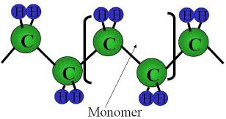
A polymers are macromolecule with high molecular mass compound ranging from 5000 to one million
Formed by combination of one or more low molecular weight compounds. The smallest unit from which polymer is obtained is called monomer.
The process by which polymers are obtained is called polymerization
For e.g. polyethylene is obtained by repeating ethylene unit as a result of polymerization.

Slide 3
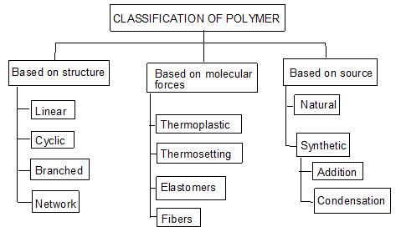

Slide 4
Classification based on source
Naturally occurring Polymers: These occur in plants and animals and are very essential for life e.g. starch, cellulose, amino acids, etc.
Synthetic polymers: These polymers are prepared in laboratory they are man made polymers e.g. plastics, synthetic rubbers, etc.
Semi synthetic polymers: These are derived from naturally occurring polymers by chemical modification. e.g. vulcanized rubber, Cuprammonium silk and Cuprammonium rayon, etc.

Slide 5
Classification based on Molecular forces
Polymers are classified into four categories based on magnitude of intermolecular forces
Elastomers: In these polymers, chain are held by weakest intermolecular forces which permits the polymers to be stretched. The polymer regains its original position when forces are released.
Fibers: In these polymers the inter molecular forces are strong due to hydrogen bonding, cross linking, cyclic structure
Thermoplastics: These are polymers for which inter molecular forces between elastomers and fibers. Due to this they can be easily molded by heating.
Thermosetting polymers: Thermosetting polymers undergo chemical changes and cross linking on heating and become permanently hard and infusible.

Slide 6
Classification based on Tacticity
Isotactic polymers: In isotactic, all the functional group lie on the same side of chain
Syndiotactic polymers: In syndiotatactic, functional group arrangement is alternate

Slide 7
Atactic polymers: In atactic, functional group arrangement is random
Every other carbon in the chain is a stereo-center

Slide 8
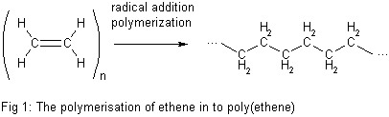
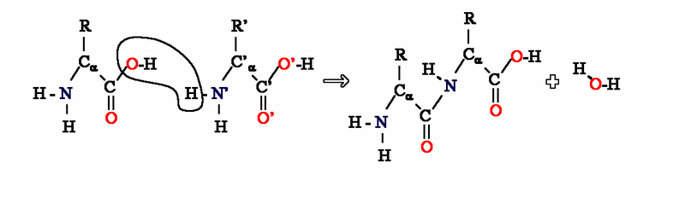
Classification based on Polymerization method
Addition Polymerization: A polymer formed by direct repeated addition of monomers is called addition polymerization. In this types of polymers monomers are unsaturated compounds or derivatives of alkenes.
Condensation Polymerization: Condensation polymerization involves condensation of two different monomers which are normally bi functional group. During the process there is loss of small molecule such as water

Slide 9
Plastics
Plastic is a substance that can be easily moulded into a desired shape by the effect of mechanical force & heat.
In the manufacturing of plastic raw materials like coal, petroleum, cellulose, salt, sulphur, limestone, air, water etc. are used.
Plastics as engineering materials:-
Low fabrication cost, low thermal & electrical conductivities, high resistance to corrosion, Plastics are resistant to chemicals & solvents
Plastics reduce noise & vibrations in machines
Plastics are bad conductors of heat are useful for making handles used for hot objects, most plastics are inflammable.
Plastics are electrical insulators & find large scale use in the electrical industry.
Plastics are clear & transparent so they can be given beautiful colors.

Slide 10
Compounding of plastics
The process of mechanical mixing of various additives with polymers (resin) to impart some special properties to the plastics.
The additives gets incorporated with resins to give homogeneous mixture.
The principle Additives / Ingredients used in compounding are:
Resin or Binder
Fillers or extenders
Plasticizers
Pigments or Dyes
Activators, catalysts or accelerators
Lubricants
Stabilizers

Slide 11
1. Resin (Binder)
Resin is binder which holds the various constituents together
High molecular weight substances such as, synthetic resins, cellulose derivatives etc.
Binders influence the properties of plastics
They also decide the type of treatment during moulding operation

Slide 12
2. Fillers or extender
Fillers reduce cost of the plastic without affecting its original properties
Imparts better tensile strength, hardness, finish, workability, opacity to the plastic
Highest % can be up to 50 %, which depends upon type of plastic
The fillers which increase mechanical strength are known as reinforce fillers
They also reduce shrinkage and brittleness
Eg. Organic fillers: wood powder, cotton pulp, carbon black, graphite, powdered rubber
Inorganic fillers: Asbestos, powdered mica, clays, talc, Zn & Pb oxides, Cd & Ba sulphides, carborundum.

Slide 13
3. Pigments / Dyes
Imparts desired color
Organic dyes and inorganic pigments
Eg. Azo dyes, chromate pigments

Slide 14
4. Catalysts or accelerators
Used for thermosets to increase the rate of cross-linking
Acidic or basic catalysts can be used
Just the small quantities are required
Eg. Benzoyl peroxide, hydrogen peroxide, metal oxides

Slide 15
5. Plasticizers
This increase the flexibility and mouldability and to decrease brittleness of the materials.
It also lowers the temperature of moulding operation
Increase workability and flame proof-ness of plastics
Only used in thermo-softening plastics
When they mixed with the resin, they get uniformly distributed between the molecules and reduce intermolecular attraction between original polymer molecules. Thus the plastic becomes flexible.

Slide 16
5. Plasticizers
They can be added upto 10 %
Generally liquid plasticizers are used, hence the only disadvantage is, if they are not consistent they could ooze out from the finished product.
Examples
Cresyl diphenyl phosphate
Tricresyl phosphate
Triphenyl phosphate
Esters of oleic and stearic acids

Slide 17
6. Lubricants
Especially help during low or room temperature moulding
This gives the glossy finish to the final product
As lubricants get dispersed on the surface and occupies a layer between article and mould
This prevents sticking of an article to the mould and its easier separation from the mould
Eg. Soaps, waxes

Slide 18
7. Stabilizers
Improves thermal stability of the plastics
Generally helps in high temperature moulding operations, where some plastics decompose or gets decolorized
This could be prevented with the help of stabilizers
Eg.
Diethyl phthalate
Adipic acid esters

Slide 19
Fabrication (Molding) of Plastics
Giving any desired shape to the plastics (granules or powders) by using mould under the application of heat and pressure. A proper method is to be selected depending on the shape and type of resin used. Methods involves partial melting of resinous mass by heating.
In case of thermo-plasts molten resin is introduced in die/mould and desired shape could be achieved by compression and further cooling.
In case of thermo-sets partially polymerized mass or raw materials are introduced in the die/mould, which further cured at high temperature in the mould itself to achieve desired shape.
Note:
In case of thermoplasts, curing is done at room temperature (low temperature), while in case of thermosets, curing is done at high temperature to obtain desired cross-linking

Slide 20
Four important types of fabrication Methods
Compression Molding : (Suitable for Thermosets / Thermoplasts)
Injection Molding : (Suitable for Thermoplasts)
Transfer Molding : (Suitable for Thermosets)
Extrusion Molding : (Suitable for Thermoplasts)

Slide 21
Compression Molding
Common and oldest method for molding thermosetting / thermoplastic materials
Compression of raw materials or soften resinous mass is done in the mould/die under heat and pressure
Predetermined quantity of raw materials is introduced carefully in the mould, further compressed by hydraulic pressure (2000 to 10000 psi)
Molten or soften resinous mass gets filled in the cavity of mould.
Curing is done by heating (Thermosetting) or by cooling (Thermoplastics)
Finally moulded article is separated from the mould by opening the mould apart.
Applications : Electric switch boxes, Ash trays, cabinets for radio, television, computers etc.

Slide 22
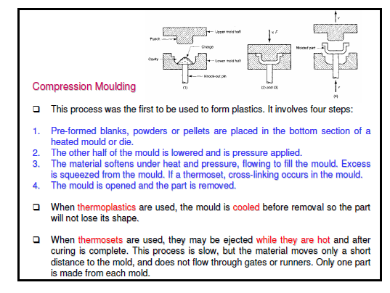

Slide 23
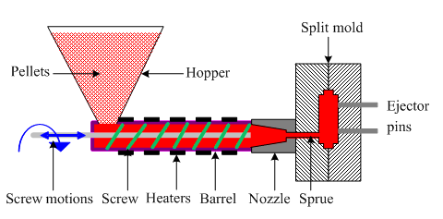
Injection Molding
Especially used for thermoplastic materials
Powder or granular resin is heated in a cylinder and injected at a controlled rate in a mould
Piston plunger or screw is used to force the material in mould.
Pressure upto 1758 kg/cm² (125 psi) is used
Once the article is formed mould is cooled and half mould is opened to remove the finished article.
Disadvantage of the method is formation of air bubbles or cavities in the articles
Applications: Smaller but large volume articles such as, pen caps, bottle caps, cups, containers, mechanical parts

Slide 24
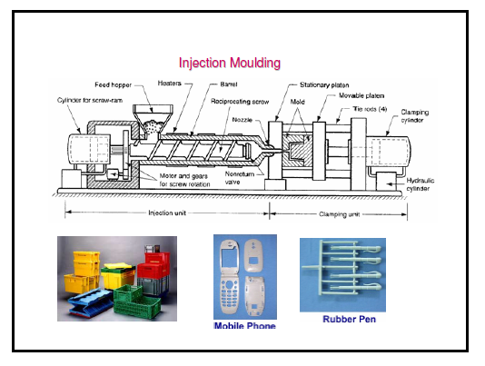

Slide 25
Transfer Molding
The method combines features of both Compression Molding (hydraulic pressing of molding materials - thermosets) and Injection Molding (ram-plunger and filling the mold through a sprue).
The method is used especially for molding thermosetting resins (thermosets)
Products with relatively intricate designs could be fabricated with this method
Powdered raw materials are heated at certain low temperature to soften and then introduced through an orifice or sprue in the mould
Then it is cured in the mould at high temperature for certain time
Finally the moulded article is removed by separation of mould
Advantages:
Articles with intricate shapes could be designed
Aerospace and automobile parts, car body, helmets
The articles produced are blister free
Fine wires and glass fibers can be inserted in the mould
Even thick pieces can be cured completely and uniformly

Slide 26
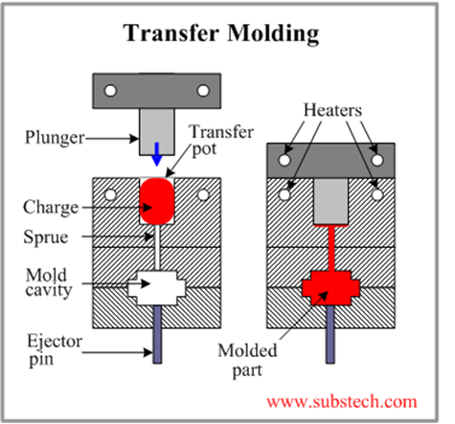
Transfer Molding

Slide 27
Extrusion Molding (Horizontal)
The method is used for the manufacturing of continuous type of thermoplastic articles with constant cross-section. Eg. Tubes, rods, strips, insulated electric cables
Dry powder or granules of thermoplastic materials are introduced through hopper and further melted by heating.
There are two types of extrusion moulding:
Vertical extruder moulding
Horizontal extruder moulding
Molten mass is pushed through the orifice of the die by using screw
Once the article leaves the orifice, it is allowed to pass through water for solidification
Proper temperature control of heating chamber and the speed of the screw are the major factors behind successful operation

Slide 28
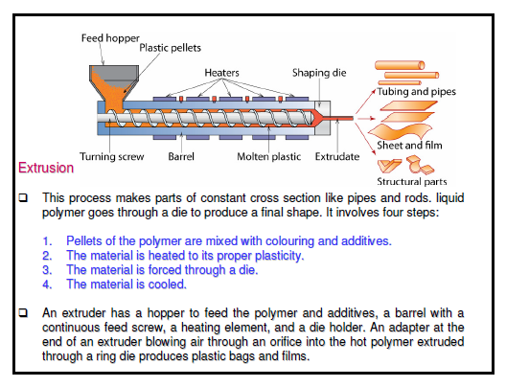
Extrusion Molding (Horizontal)

Slide 29
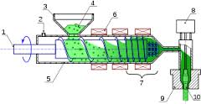
Extrusion Molding (Vertical)

Slide 30
 | Condensation polymerisation |  | Additional polymerisation
(1) | It is also known as step growth | (1) | It is also known as chain growth
 | polymerisation |  | polymerization
(2) | It takes place in monomers having | (2) | It takes place only in monomers
 | reactive functional groups |  | having multiple bonds.
(3) | It takes place with elimination of | (3) | It takes place without elimination of
 | simple molecule like H₂O,NH₃,HCl |  | simple molecule.
 | etc.,
(4) | Repeat units of monomers are | (4) | Repeat units & monomers are same.
 | different
(5) | The polymer is formed in gradual | (5) | Reaction is fast and polymer is formed
 | steps |  | at once.
(6) | The molecular mass of polymer | (6) | There is very little change in the
 | increases throughout the reaction |  | molecular mass throughout the
 |  |  | reaction
(7) | Product obtained may be | (7) | Product obtained are thermoplastic
 | thermosetting/thermoplastic
(8) | E.g.:- Bakelite, polyester ,polyamides | (8) | E.g:-Polyethylene, PVC, poly styrene.
 | etc.,

Slide 31
Molecular Mass of Polymer
The molecular mass of polymer is an important property of polymer because many important properties are influenced by molecular mass. Polymers with higher molecular mass are tougher and more resistant. Their viscosities and softening temperature are also higher. Thus polymers with desired molecular mass are often required for particular purposes.
Molecular mass of polymer is not a fixed or constant value like organic compound. Their molecular mass is controlled by polymerization reaction, which in turn depends upon availability of functional group, charge carrier, life time of charge carriers. Because of random nature of growth process, the product of polymerization process is mixture of chains of different length.
Hence polymers are poly disperse mixture of various molecular mass polymers. Therefore molecular mass of polymers is average molecular mass

Slide 32
Synthesis and Applications of Commercially important Polymers [Preparation, Properties and Uses]

Slide 33
Some Important Polymers
Poly Vinyl Acetate (PVAc): Y
Poly Methyl Methacrylate (PMMA):Y
Poly-Paraphenylene Terephthalamide (KEVLAR):Y
Polylactic acid: Y
PDMS: Y
(Also refer to PDF notes)

Slide 34
1. Poly Vinyl Acetate (PVAc)
Polyvinyl acetate is a polymer produced through the combination of several units of monomeric vinyl acetate (CH₃COOCH=CH₂).
The number of units so combined is typically between 100 and 5,000.
This translates to an average molecular weight between 850 and 40,000.

Slide 35
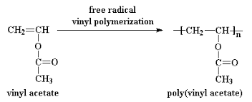
1. Poly Vinyl Acetate (PVAc)
Preparation:
Vinyl acetate Monomer is prepared by reacting acetylene with anhydrous acetic acid in the presence of a mercurous sulfate catalyst; poly vinyl acetate is prepared by free radical vinyl polymerization as follows:

Slide 36
1. Poly Vinyl Acetate (PVAc)
Properties:
Polyvinyl acetate is an amorphous polymer
The hardest of the polyvinyl esters, polyvinyl acetate offers good adhesion to most surfaces.
Unlike some other thermoplastics, it will not turn yellow.
Polyvinyl acetate does not cross-link, and it can be dissolved in many solvents other than water.
One slow-drying formulation combines 5 to 15 percent polyvinyl acetate with ethyl alcohol (ethanol).
A fast-drying counterpart combines the same amount of polyvinyl acetate with acetone (dimethyl ketone).

Slide 37
1. Poly Vinyl Acetate (PVAc)
USES:
Emulsified polyvinyl acetate is used in water-based adhesives, including pastes and glues.
One of the uses for emulsified polyvinyl acetate is in bookbinding, depending upon the necessary lifetime of the book, the polyvinyl acetate chosen will either be co-polymeric or homo-polymeric.
Polyvinyl acetate offers acceptable gap-filling capability.
It may be used as a resinous component of latex paints, offering compatibility with a wide-range of other paint chemicals.
Polyvinyl acetate may be used in the lamination of metal foils.
Non-emulsified, or waterless, polyvinyl acetate is useful as a thermosetting adhesive.

Slide 38
2. Poly Methyl Methacrylate (PMMA)
Poly-(methyl methacrylate) (PMMA), also known as acrylic or acrylic glass as well as by the trade names Crylux, Plexiglas, Acrylite, Lucite, and Perspex
It is a transparent thermoplastic often used in sheet form as a light-weight or shatter-resistant alternative to glass.
The same material can be used as a casting resin, in inks and coatings, and has many other uses.

Slide 39
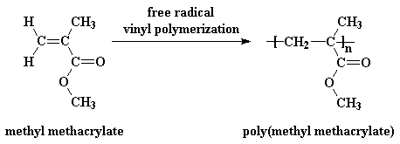
2. Poly Methyl Methacrylate (PMMA)
Preparation:
PMMA is routinely produced by emulsion polymerization, solution polymerization, and bulk polymerization.
It is generally prepared by radical initiation method.

Slide 40
2. Poly Methyl Methacrylate (PMMA)
Properties:
PMMA is a strong, tough, and lightweight material.
It has a density of 1.17–1.20 g/cm³, which is less than half that of glass.
It also has good impact strength, higher than both glass and polystyrene. [PMMA's impact strength is still significantly lower than polycarbonate]
PMMA transmits up to 92% of visible light (3 mm thickness), and gives a reflection of about 4% from each of its surfaces due to its refractive index (1.4905 at 589.3 nm).
It filters ultraviolet (UV) light at wavelengths below 300 nm.
PMMA swells and dissolves in many organic solvents; it also has poor resistance to many other chemicals due to its easily hydrolyzed ester

Slide 41
2. Poly Methyl Methacrylate (PMMA)
Uses:
Being transparent and durable, PMMA is a versatile material and has been used in a wide range of fields and applications such as rear-lights, appliances, and lenses for glasses.
PMMA is used for building windows, skylights, signs & displays, sanitary ware (bathtubs), LCD screens, furniture and many other applications.
It is also used for coating polymers based on MMA provides outstanding stability against environmental conditions with reduced emission of VOC.
Methacrylate polymers are used extensively in medical and dental applications where purity and stability are critical to performance.

Slide 42
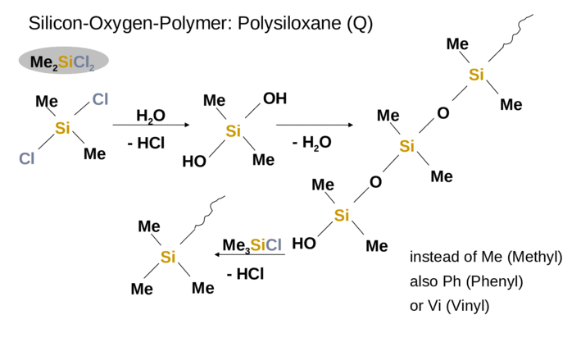
3. Poly Di-Methyl Siloxane (PDMS)

Slide 43
Properties-
Service temperature to about 260 °C
Good chemical resistance, low water absorption, good electrical
properties, & available in flame retardant grade
Very low glass transition temperature (Tg = -120 °C)
high molecular weights but not a solid
Ability to spread out on a wide variety of substrates
silky, non-tacky, aesthetic enhancing flowability and film forming
Lowest surface shear viscosity and low surface tension
lubricating, antifoaming, waterproofing, release properties
High gas permeability
Excellent dielectric properties
Very good thermo-oxidative stability
good chemical inertness and temperature resistance

Slide 44
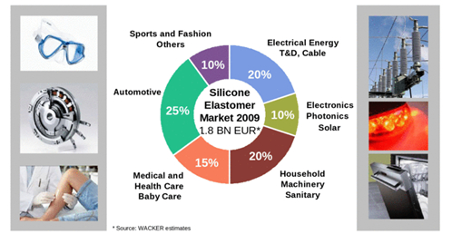
Uses-
In the plumbing and automotive fields, silicone grease is often used as a lubricant. In plumbing, the grease is typically applied to O-rings in faucets and valves.
In the automotive field, silicone grease is typically used as a lubricant for brake components since it is stable at high temperatures, is not water-soluble

Slide 45
Conducting Polymers
Generally polymers are insulators because of the absence of free electrons.
But they can be made conductive in certain cases by the process called doping.
Two conditions for the polymer to become conducting are:
Polymers should possess conjugated double bonds
Polymer structure has to be disturbed either by adding or removing electrons by the process of doping.
There are 3 major classes of conducting polymers
Intrinsically conducting polymers
Doped conducting polymers
Extrinsically conducting polymers

Slide 46
1. Intrinsically conducting polymers
This belong to a class of organic materials consist of Conjugated pi-electrons in the backbone of their macromolecules which is responsible for high electrical conductivity.
In an electric field, conjugated pi-electrons of the polymer gets excited and can be transported through the solid polymer.
Overlapping of orbitals of conjugated pi-electrons over the entire backbone of the polymer results in the formation of valence bands and conduction bands. This induces conductivity in the presence of electric field.
For example:
Poly-acetylene, poly-aniline, poly-pyrolle and poly-thiophene etc.

Slide 47
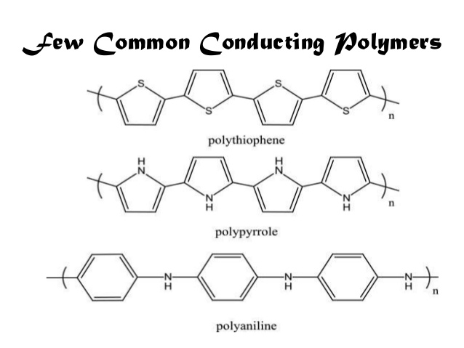


Polyacetylene

Slide 48
Due to their high electrical properties, ICPs are intensively investigated for application in electronics, microelectronics, optoelectronics mainly for areas in aerospace and automobile industries.
Among the most promising applications of the ICPs are corrosion protection, solid-state charge storage devices, electromagnetic screens, antistatic coatings and gas separation coatings.
However, poor mechanical properties, environmental sensitivity, moderate stability of electrical properties with temperature significantly limit the industrial applicability of ICPs.

Slide 49
2. (DCP) Doped conducting polymer
While the addition of a donor or an acceptor molecule to the polymer is called "doping ", the reaction that takes place is actually a redox reaction.
The first step is the formation of a cation (or anion), which is called a soliton or a polaron.
Pn ⇔ [Pn + A – ] (reduction oxidation)
As synthesized conductive polymers exhibit very low conductivities. It is not until an electron is removed from the valence band (p-doping) or added to the conduction band (n-doping, which is far less common) does a conducting polymer become highly conductive.
Doping (p or n) generates charge carriers which move in an electric field. Positive charges (holes) and negative charges (electrons) move to opposite electrodes. This movement of charge is what is actually responsible for electrical conductivity.

Slide 50
(DCP) Doped conducting polymer
This is obtained by exposing a polymer to a charge transfer agent in a gas phase or in solution.
Conductivity of ICPs can be increased by creating positive or negative charges on the polymer backbone by oxidation or reduction by the process of doping.
1. p-doping involves treating intrinsically conducting polymer with a Lewis acid thereby oxidation takes place and positive charges on the polymer backbone are created. Some common P-dopants are I₂, Br₂, AsF₅, PF₆ etc.

Slide 51
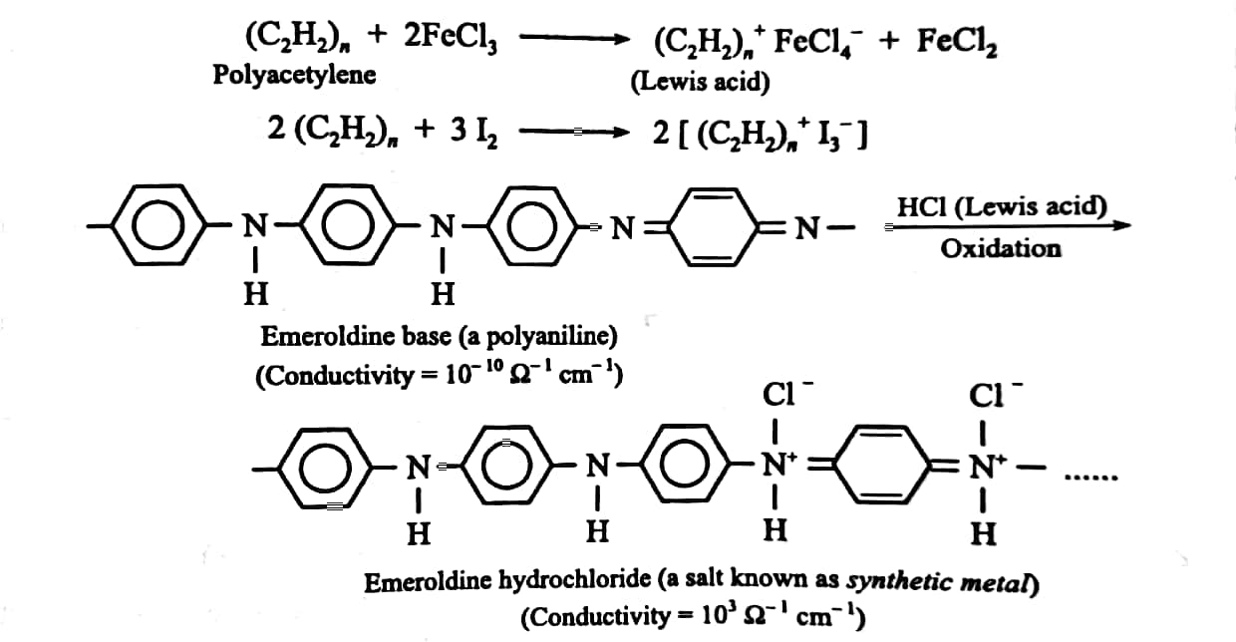

Slide 52
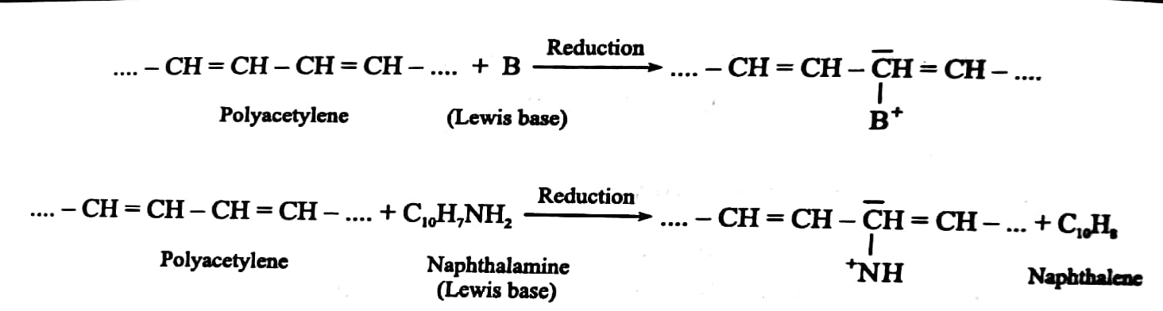
2. n-doping involves treating intrinsically conducting polymer with a Lewis base thereby reduction takes place and negative charges on the polymer backbone are created. Some common N-dopants are Li, Na, Ca etc.

Slide 53
3. Extrinsically Conducting Polymer
This type of conducting polymers possesses conductivity due to the presence of externally mixed conducting elements or compounds. These are of the following two types:
conductive element filled polymer: Such polymers contains non-conducting polymers (behaving as binder) holds the conducting elements or compounds (behaving as conducting filler) such as carbon black, metals, metal oxides, etc. Such polymers possesses good bulk conductivity, low cost, light weight, mechanically tough and easily processable.
Blended conducting polymer: such polymers are obtained by blending conventional polymers with conducting polymers either through physical or chemical process.

Slide 54
Applications of conducting polymers
In rechargeable light weight batteries
In optical display devices
In aircrafts and aerospace components
In diodes and transistors
In solar cells

Slide 55
Liquid-crystal polymers (LCPs)
An Austrian botanist named Friedrich Reinitzer studied a material called as cholesteryl benzoate which showed two distinct melting points. He noticed the change of crystal structure to hazy liquid by increase the temperature of solid sample.
Later on further heating, the hazy liquid converted to transparent liquid.
Reinitzer discovered a new phase of matter that is called as liquid crystal phase. Such materials show unique properties and have several new applications in modern technology.
Liquid-crystal polymers (LCPs) are a class of aromatic polymers. They are extremely unreactive and inert, and highly resistant to fire.
Liquid crystallinity in polymers may occur either by dissolving a polymer in a solvent (lyotropic liquid-crystal polymers) or by heating a polymer above its glass or melting transition point (thermotropic liquid-crystal polymers).

Slide 56
Liquid-crystal polymers (LCPs)
Liquid-crystal polymers are present in melted/liquid or solid form. In solid form the main example of lyotropic LCPs is the commercial aramid known as Kevlar. Chemical structure of this aramid consists of linearly substituted aromatic rings linked by amide groups. In a similar way, several series of thermotropic LCPs have been commercially produced by several companies. The orientation of molecules in liquid crystal state is intermediate liquid and solid phases. This intermediate state I called as mesogenic state or liquid crystal state. In such materials the properties of a material depend on the direction in which they are measured. The liquid crystalline structure has positional order, orientational order and bond orientational order.

Slide 57
Properties
1. Typically, LCPs have a high mechanical strength at high temperatures, extreme chemical resistance, inherent flame retardancy, and good weatherability.
2. Liquid-crystal polymers come in a variety of forms from sinterable high temperature to injection moldable compounds.
3. LCPs can be welded, though the lines created by welding are a weak point in the resulting product.
4. LCPs have a high coefficient of thermal expansion and are exceptionally inert.
6. They resist stress cracking in the presence of most chemicals at elevated temperatures, including aromatic or halogenated hydrocarbons, strong acids, bases, ketones, and other aggressive industrial substances.
7. Hydrolytic stability in boiling water is excellent. Environments that deteriorate the polymers are high-temperature steam, concentrated sulfuric acid, and boiling caustic materials.

Slide 58
Uses
Because of their various properties, LCPs are useful for electrical and mechanical parts, food containers, and any other applications requiring chemical inertness and high strength.
LCP is particularly good for microwave frequency electronics due to low relative dielectric constants, low dissipation factors, and commercial availability of laminates.
Packaging micro-electro-mechanical systems (MEMS) is another area that LCP has recently gained more attention.
The superior properties of LCPs make them especially suitable for automotive ignition system components, heater plug connectors, lamp sockets, transmission system components, pump components, coil forms and sunlight sensors and sensors for car safety belts.

